Slide 1

"Scraping Real Estate Website Makaan"

Slide 2
About us
Name : Divya G. Shriwas
Qualification : M.Sc. Electronics
Any work experience : Fresher
Name : Varsha J. Deheriya
Qualification : M.Sc. Electronics
Any work experience : Fresher
I want to learn data science because I want to build my career in this digital data world . data science has huge demand in the market and great job opportunities.
I want to learn data science for skills and
career transition.
It has great job opportunities.

Slide 3
Agenda
Objective of the Project
Web Scraping
Summary of the Data
Exploratory Data Analysis:
Data Cleaning
Data Manipulation
Univariate Analysis
Bivariate Analysis
multivariate Analysis
Conclusion

Slide 4

Problem statement :
Find which type of properties available in cities.
Find in which price range affordable properties are available.
Find a best Property according to price and based on city.
Objective of the Project :
Finding a desired Property in the affordable price with respect to City.
To visualize the data using various techniques.

Slide 5
What is Web Scraping ?
Web scraping, also known as data mining, is the process of collecting large amounts of data from the website.
It takes the unstructured data into structured data that can be stored and analyzed , Save the data in a CSV file or some other structured format.
Make a request to these URLs to get the HTML of the page.
Beautiful Soup is a Python library for pulling data out of HTML and XML files.

Slide 6









Web Scraping used tools
Web scraping Tools
Data Cleaning
& Manipulating
Data visualization

Slide 7
Summary of the Data
We have selected Makaan website for our web scraping project.
Request to the website
page = requests.get('https://www.makaan.com/nagpur-residential-property/buy-property-in-nagpur-city')
Import Beautiful Soup and all the necessary libraries for scraping data
check length of all columns and create the DataFrame
Export into .csv format and read csv file and clean the Data
analysis of Univariate, Bivariate and Multivariate

Slide 8
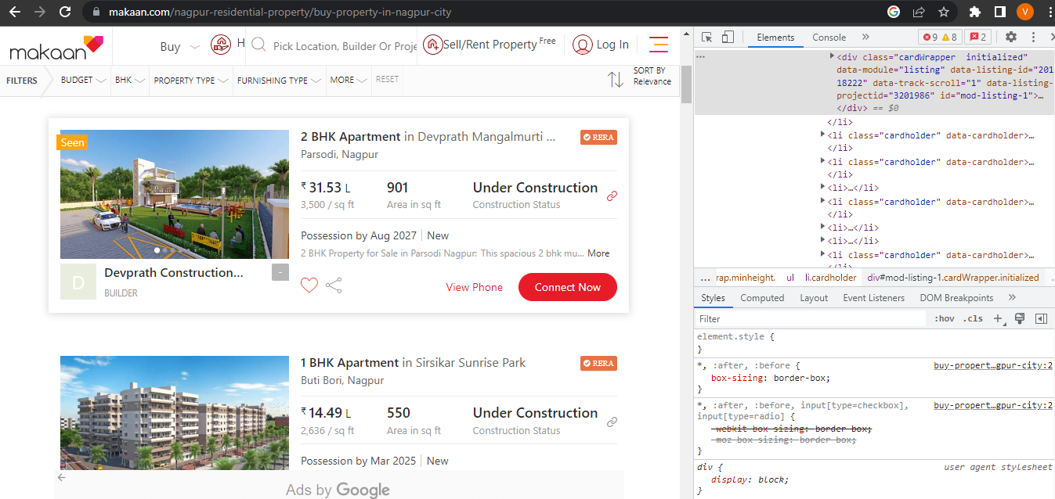
Website Used for Scraping

Slide 9
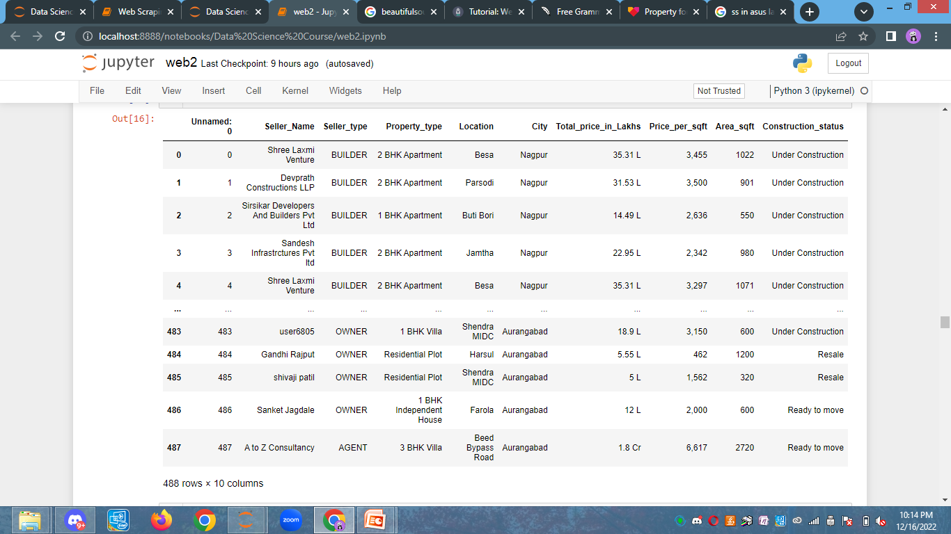
Collected Raw Data From Makaan Website

Slide 10

Exploratory Data Analysis
Data Cleaning Steps:
Check for Duplicates
Drop the duplicate column and unnecessary columns.
Checking and removing special characters.
Identifying and imputing missing values.
Data Type conversion.

Slide 11
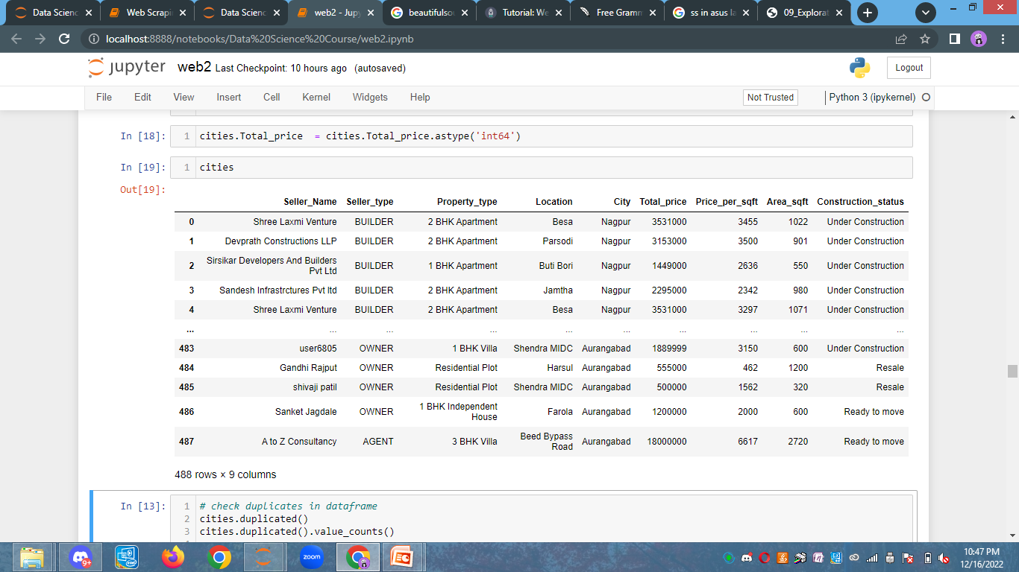
Cleaned Data

Slide 12
Data Visualisation
Univariate Analysis :
Univariate analysis explores each variable in a data set, separately.
Categorical
Numerical
Bivariate Analysis :
Bivariate analysis is a kind of statistical analysis in which two variables are observed against each other.
Categorical & Categorical
Categorical & Numerical
Numerical & Categorical
Multi-variate Analysis :
Multi-variate analysis is a kind of statistical analysis in which more than two variables are observed against each other.

Slide 13
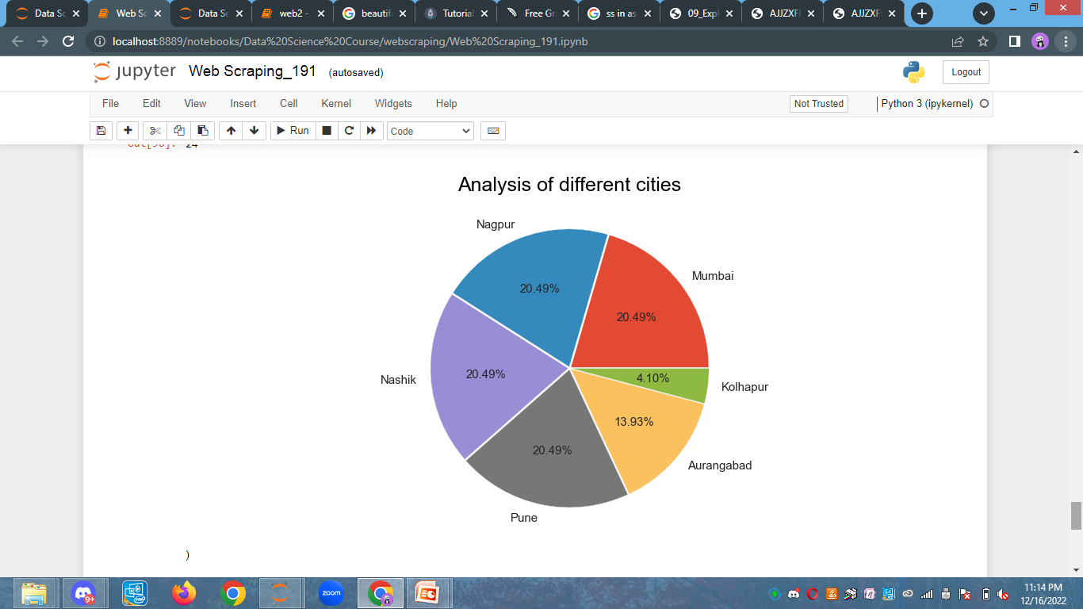
Univariate Analysis :
Analysis Of Different Cities
Observation :
We can see that,
Properties available in Pune, Nashik, Nagpur, Mumbai contributes high (20.49 %) .
Kolhapur contributes less (4.10 %) in the DataFrame.

Slide 14
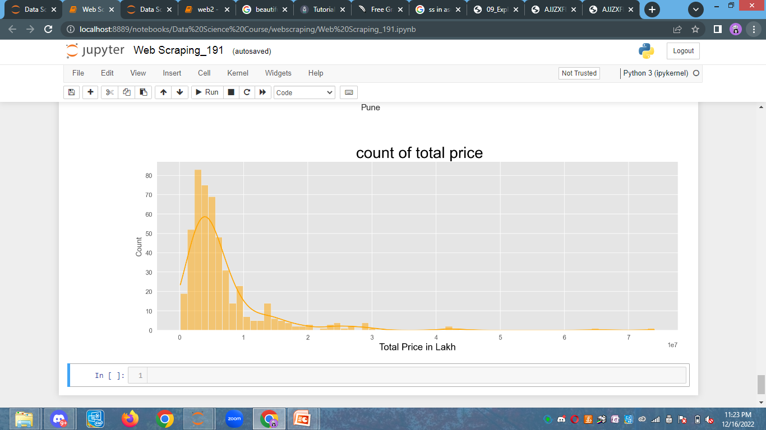
Observation :
We can see that more affordable properties available are in the range of 10 lakh to 1 crore.

Slide 15
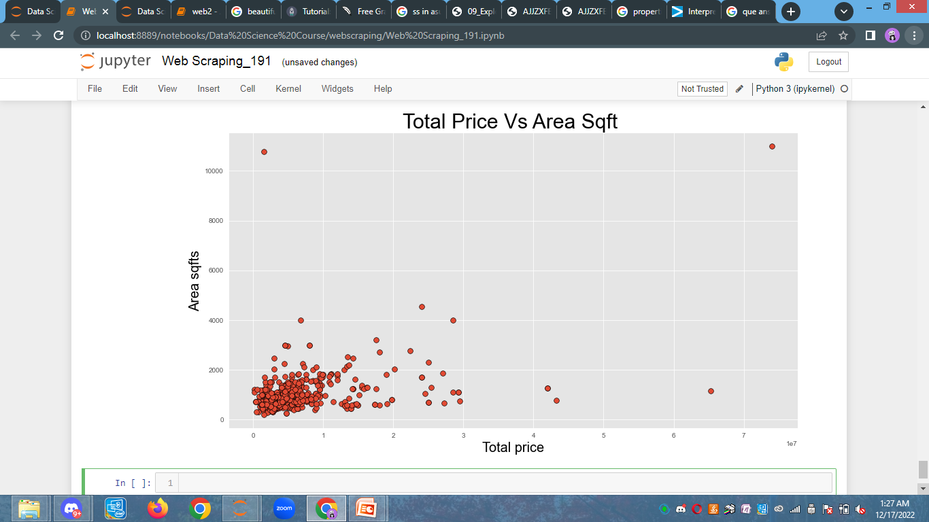
Bivariate Analysis :
Observation :
Here we can observe that if area sqft increases then price also increases.
The cluster of dots shows that more number of properties available in the range of 10 lakh to 1 crore.

Slide 16
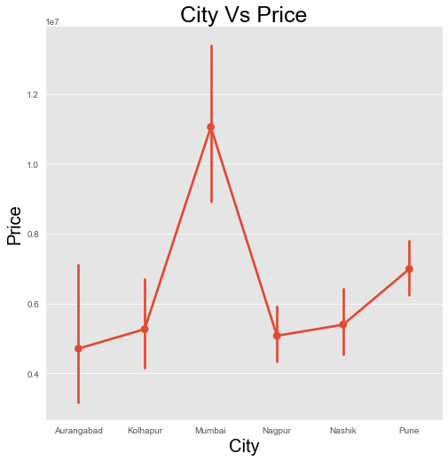
Observation :
Here we can observe that Mumbai has higher price.

Slide 17
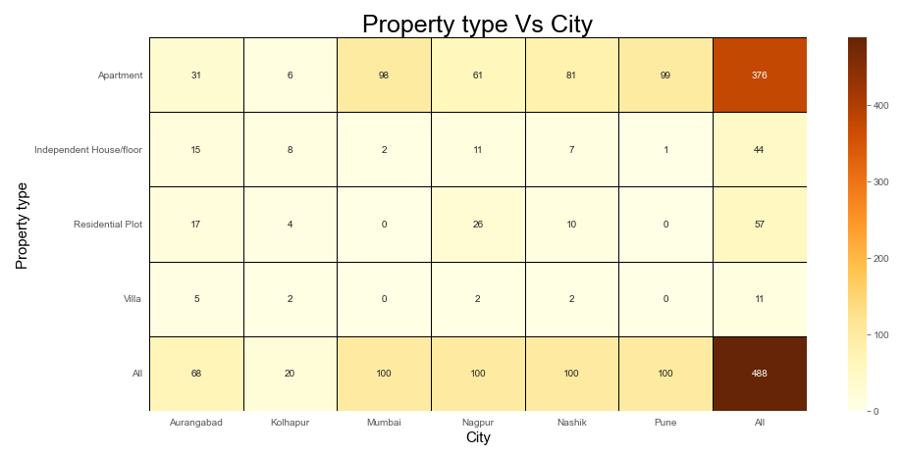
Observation :
We can easily observe that Mumbai and Pune have more apartments than other property types.
The numbers of apartments available in Mumbai, Nashik, and Pune are 98, 81, and 99, respectively.
In Mumbai or Pune, there are no villas or independent houses available.

Slide 18
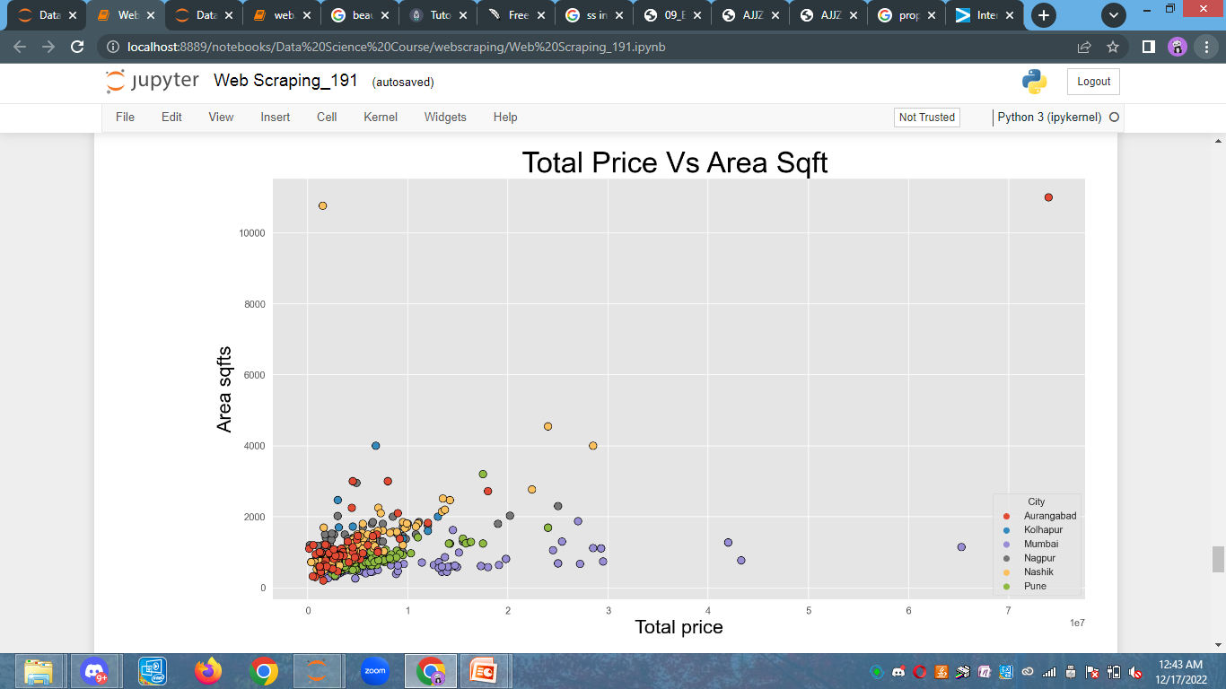
Multi-variate Analysis :
Observation :
Here we can see that if area increases in sq ft, then price also increases.
More properties are available in the cities of Mumbai, Nagpur, Nashik, and Pune, ranging from 10 lakhs to 1 crore, which are shown in different colors.

Slide 19
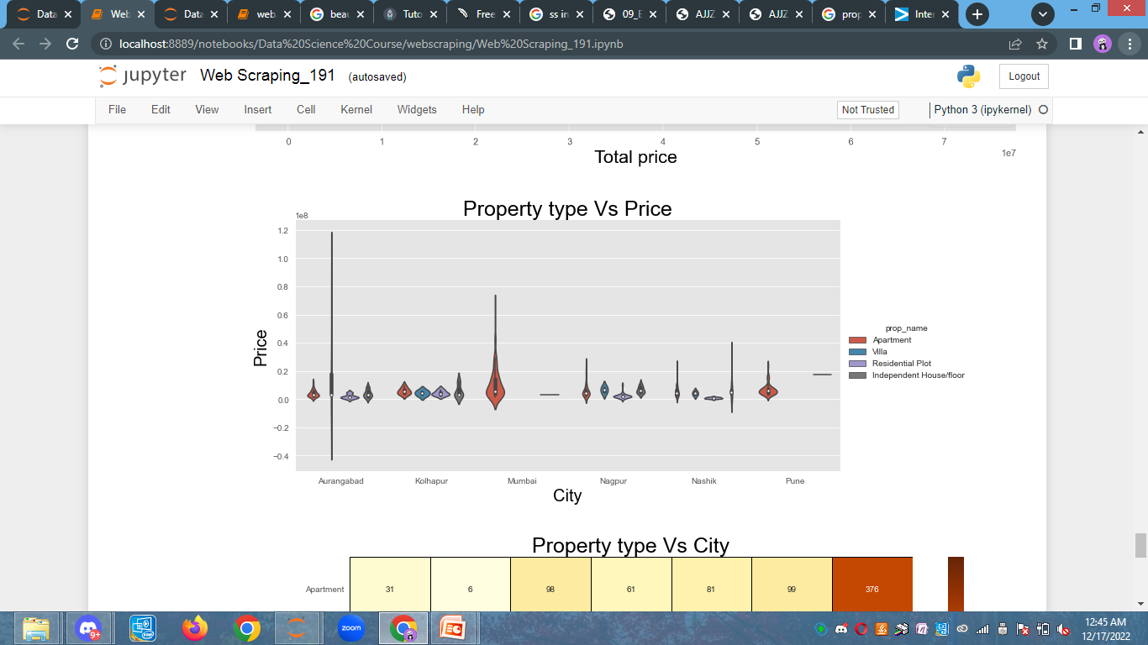
Observation :
Here we can see that in Mumbai city, the maximum number of apartments are available. There is no villa, residential plot, or independent house available.

Slide 20
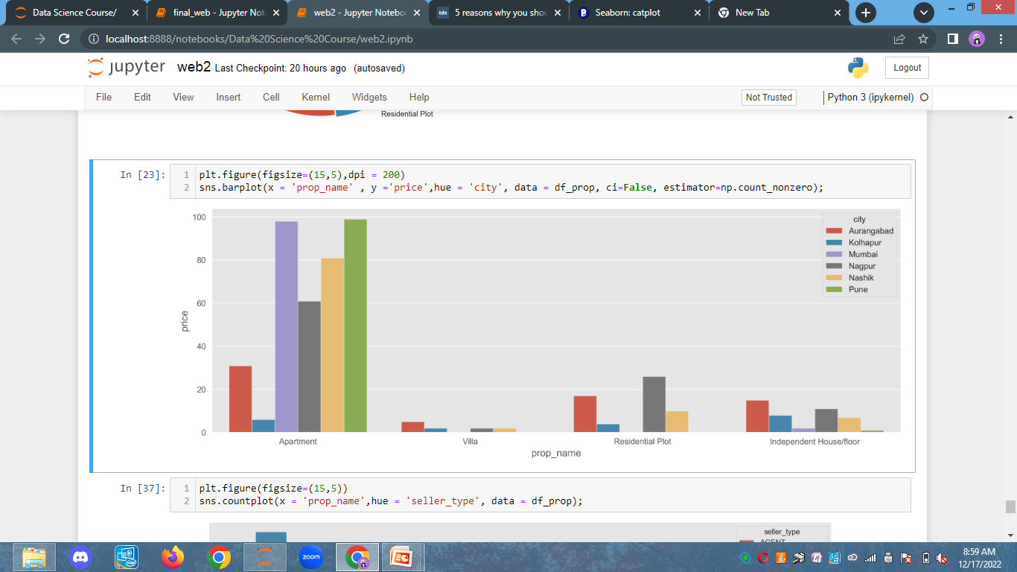
Price
Property type
Observation :
Here we can see that in Mumbai, Nagpur, Nashik, and Pune, Pune apartments prices are more.
There are fewer villas available in all cities.

Slide 21

Conclusion :
We can conclude that in Mumbai, Nagpur , Nashik and Pune apartments prices are higher as compared to other cities
We can conclude that if area increases in sq. feet then price also increases.
We can conclude that the more affordable properties available are in the range of 10 lakh to 1 crore.

Slide 22

THANK YOU

